Slide 1
Al-Farabi Kazakh National University
Higher School of Medicine
Cell differentiation and development of a multicellular organism.
Lecturer: PhD Pinsky Ilya Vladimirovich

Slide 2
LEARNING OUTCOMES
As a result of the lesson you will be able to:
1. Give the definitions to the following terms: cell differentiation, morphogenesis, embryogenesis, ontogenesis, stem cells, totipotency, pluripotency.
2. Explain how the level of expression of various genes changes during cell differentiation and at different stages of development of a multicellular organism.
3. Describe the use of stem cells in medicine and cosmetology, analyze the advantages and disadvantages of these methods.
4. Analyze the various theories of ageing in the body and the possible relationship of the ageing process with stem cells and molecular biological processes.

Slide 3
Literature:
1. Alberts et al, pp. 1145-1262.
2. Lodish et al, pp. 24-29, 975-1021.

Slide 4
Definitions
Cell differentiation is the process by which cells become specialized in order to perform different functions. The processes of organizing differentiated cells into tissues and organs are called morphogenesis.
(1) cell proliferation, producing many cells from one,
(2) cell specialization, creating cells with different characteristics at different positions,
(3) cell interactions, coordinating the behavior of one cell with that of its neighbors,
(4) cell movement, rearranging the cells to form structured tissues and organs.

Slide 5
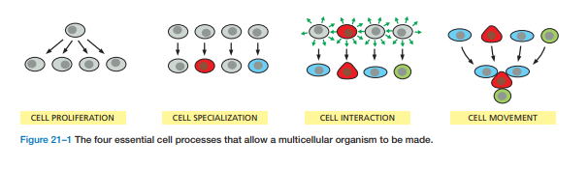

Slide 6
Embryogenesis is the individual development of an embryo.
Ontogenesis is the individual development of an organism from fertilization to death (life cycle).
Phylogenesis is the historical development of all living organisms on the Earth (evolution).

Slide 7
Stem cells are non-differentiated cells. Stem cell differentiation involves the changing of a cell to a more specialized cell type, involving a switch from proliferation to specialization.
Stem cells can be categorized into groups depending on their ability to differentiate:
Totipotent: can differentiate into all cell types;
Pluripotent: can differentiate into almost all cell types;
Multipotent: can differentiate into a related family of cell types;
Oligopotent: can differentiate into a few different cell types;
Unipotent: can produce only one cell type.

Slide 8
Examples of stem and progenitor cells in mature organism include:
Hematopoetic Stem Cells - These cells are from the bone marrow and involved in the production of red and white blood cells as well as the platelets.
Mesenchymal Stem Cells - Also from the bone marrow, these cells are involved in the production of fat cells, stromal cells as well as a given type of bone cell.
Epithelial Stem Cells - These are progenitor cells and are involved in the production of certain skin cells.
Muscle Satellite Cells - These are progenitor cells that contribute to differentiated muscle tissue.

Slide 9
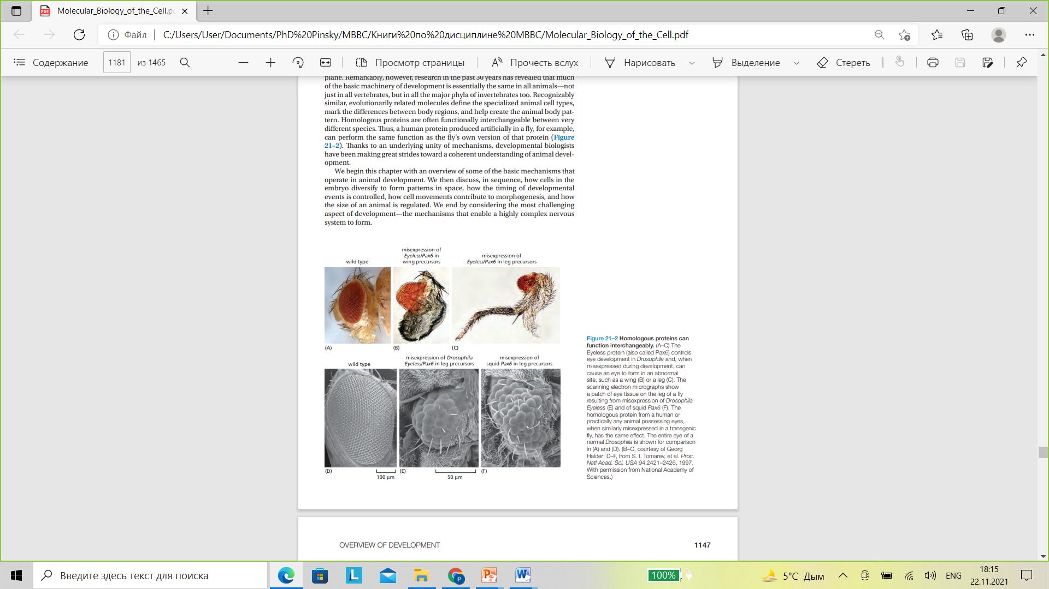

Slide 10
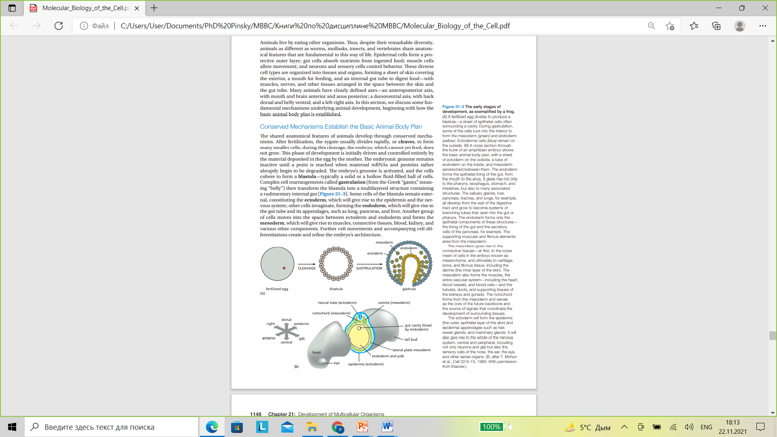

Slide 11
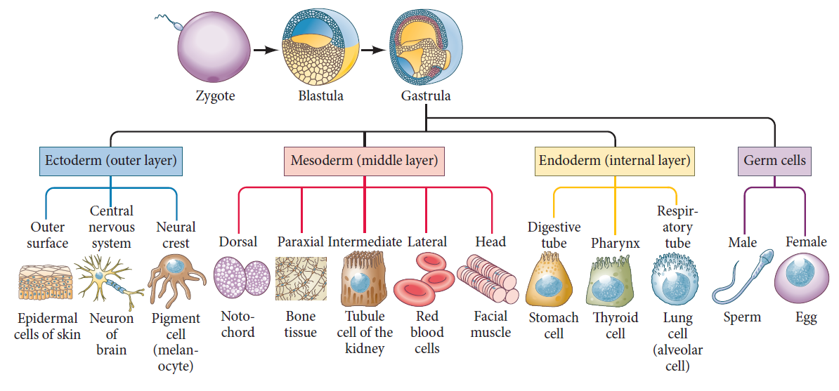
https://www.google.com/url?sa=i&url=https%3A%2F%2Freasonandscience.catsboard.com%2Ft2759-development-of-multicellular-organisms&psig=AOvVaw2QjxZyOqN3LLa9jPgHlGEL&ust=1637666907686000&source=images&cd=vfe&ved=2ahUKEwipyc7j7qv0AhWDxioKHTONBgQQr4kDegUIARCzAQ

Slide 12
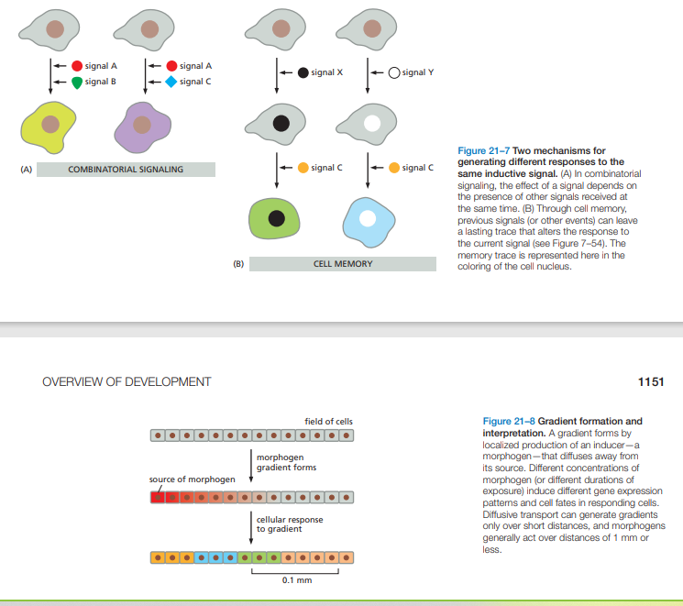

Slide 13
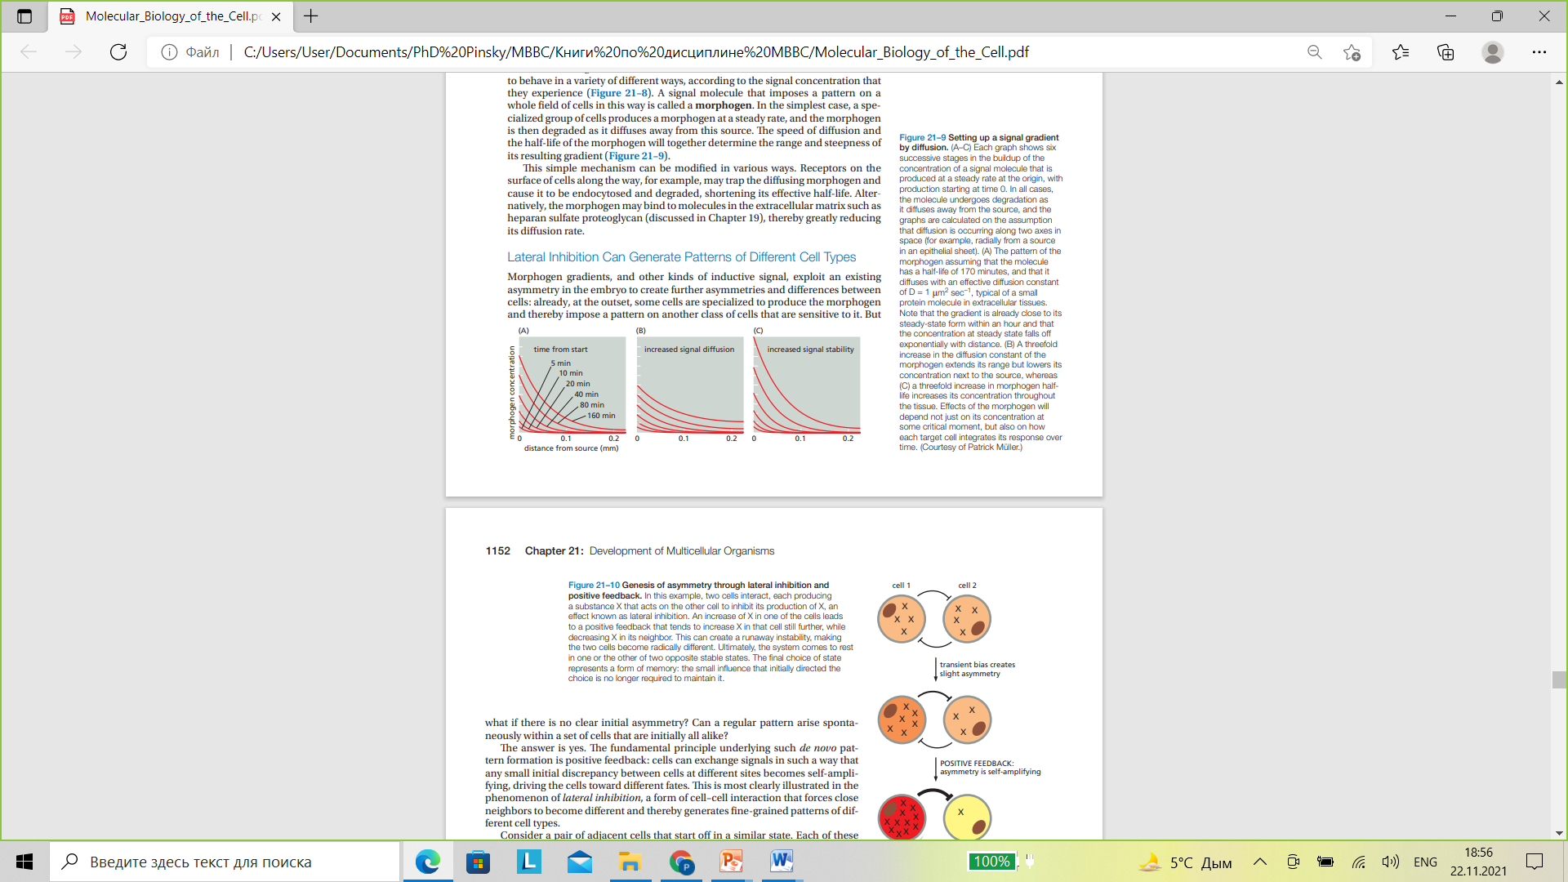

Slide 14
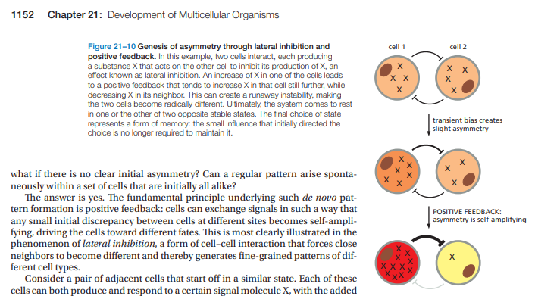

Slide 15
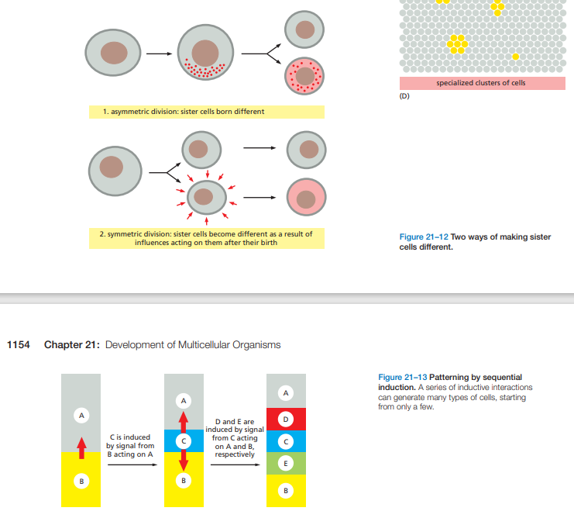

Slide 16
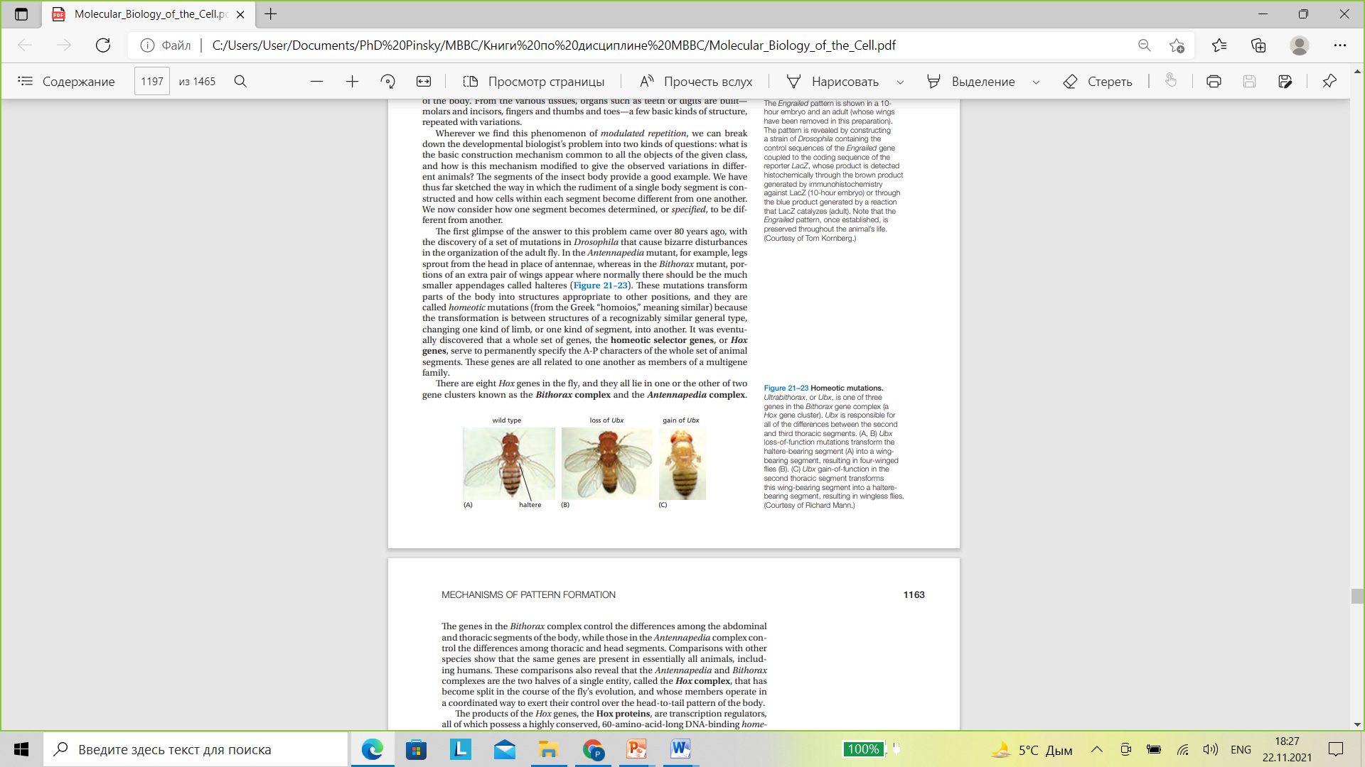

Slide 17
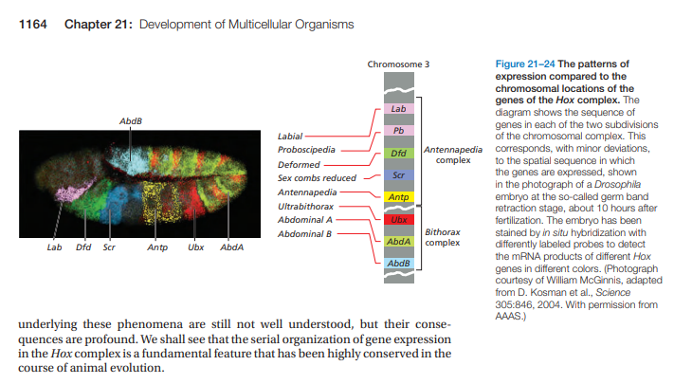

Slide 18
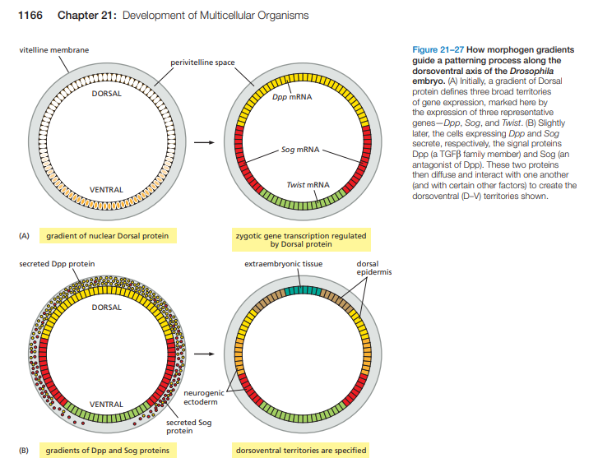

Slide 19
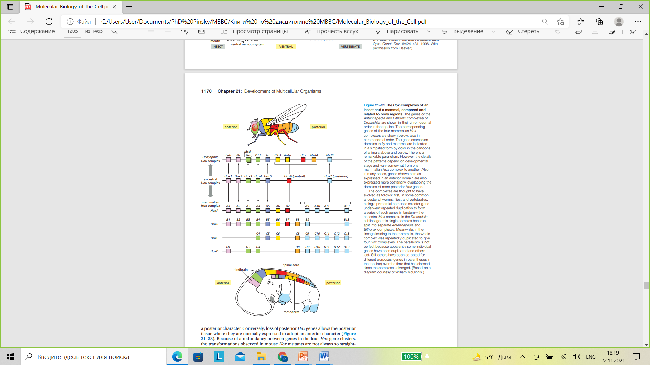

Slide 20
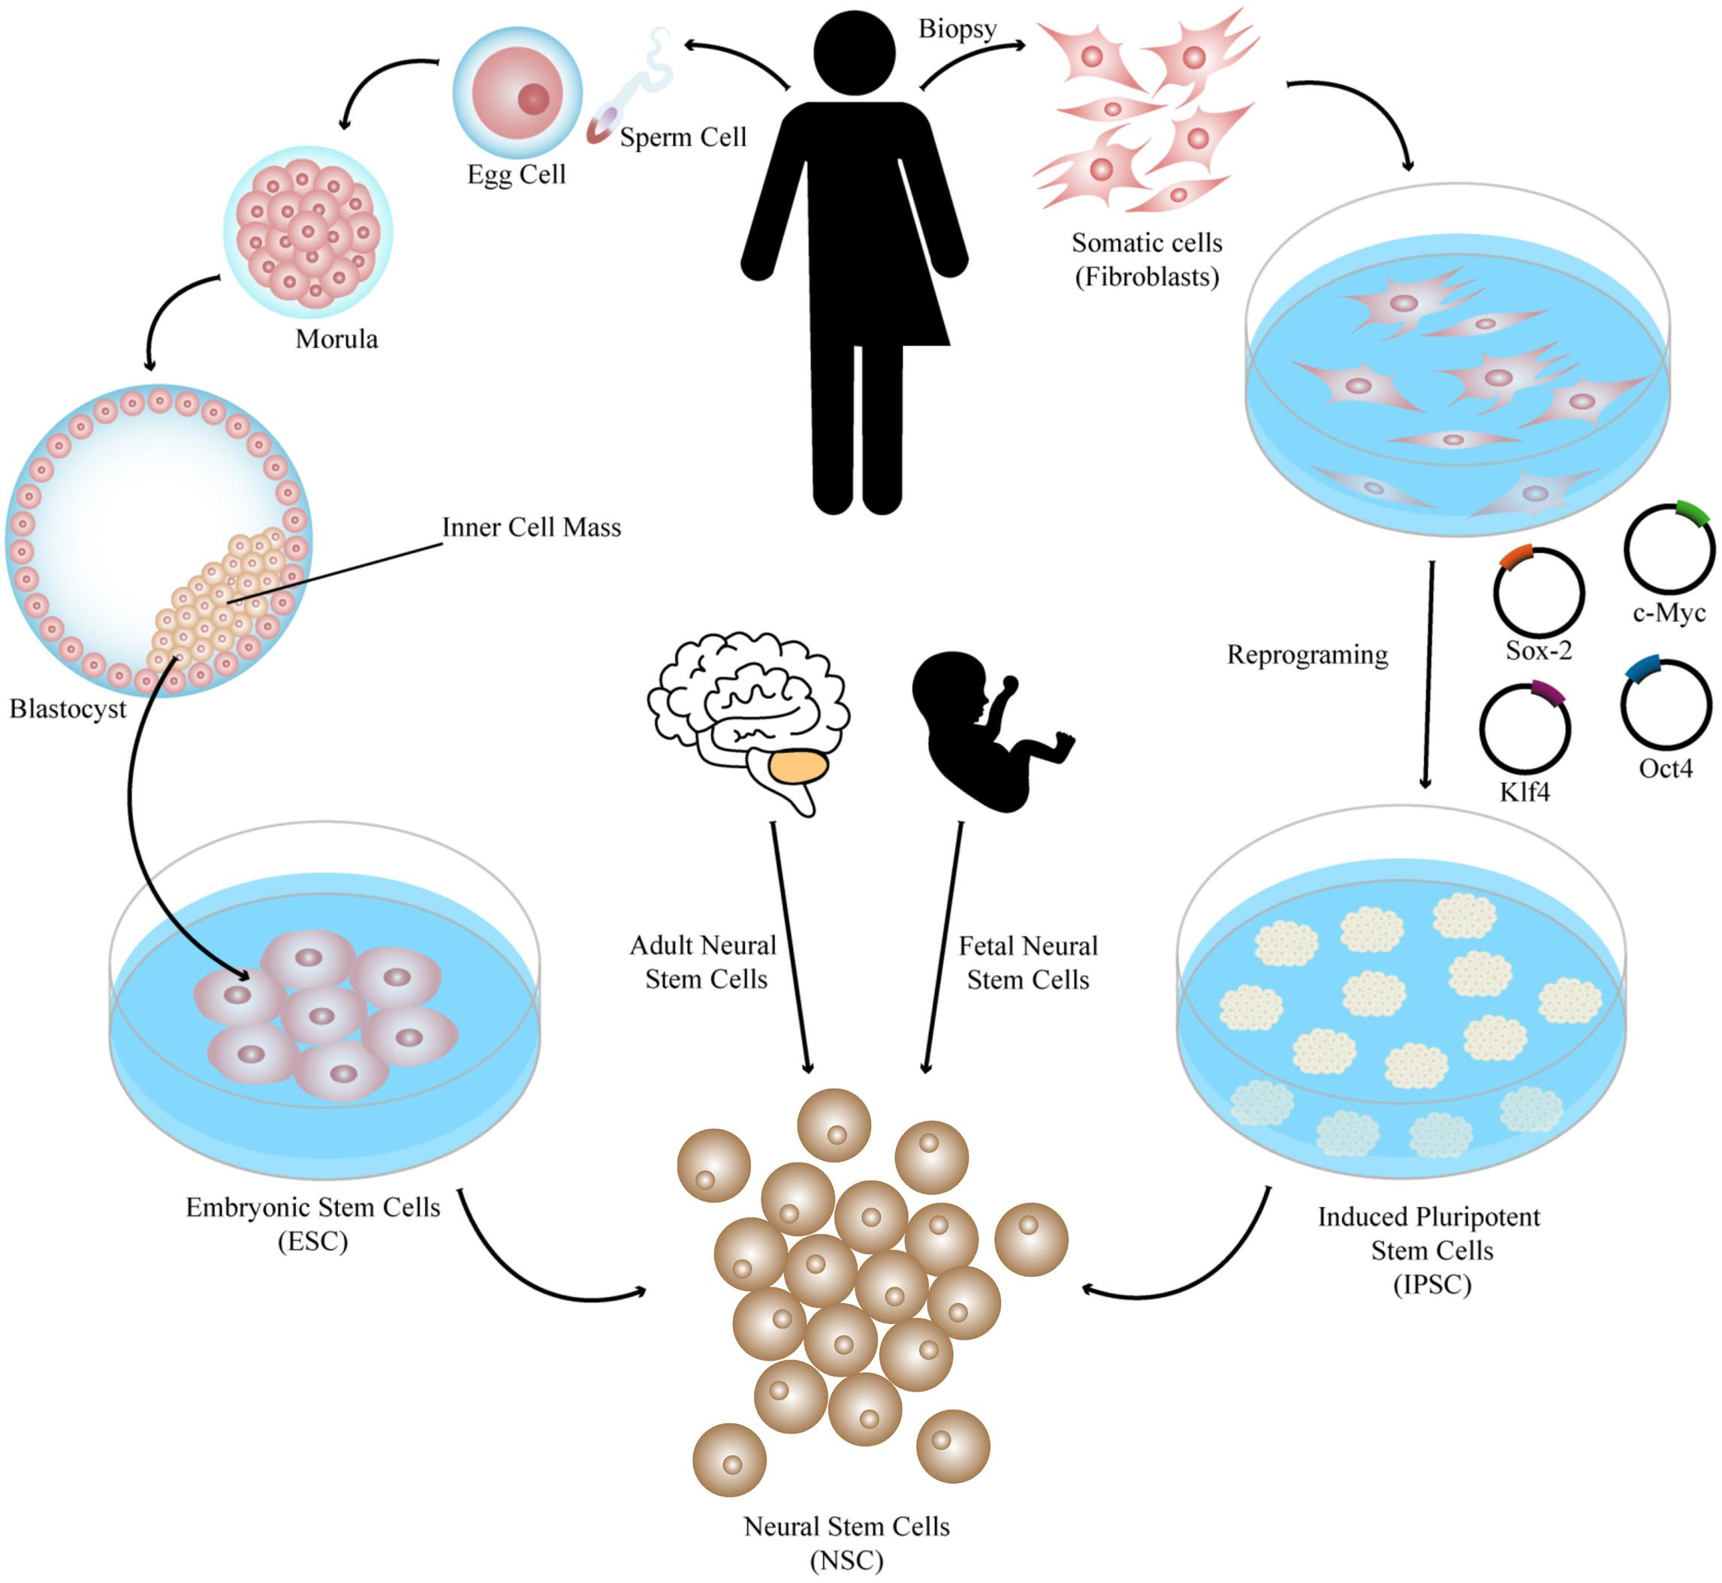
https://www.google.com/url?sa=i&url=https%3A%2F%2Fwww.frontiersin.org%2Farticles%2F481655&psig=AOvVaw3T7o9WAzxEO7sy-MxxGSiN&ust=1637675698704000&source=images&cd=vfe&ved=0CAwQjhxqFwoTCKjy4cuPrPQCFQAAAAAdAAAAABAJ

Slide 21
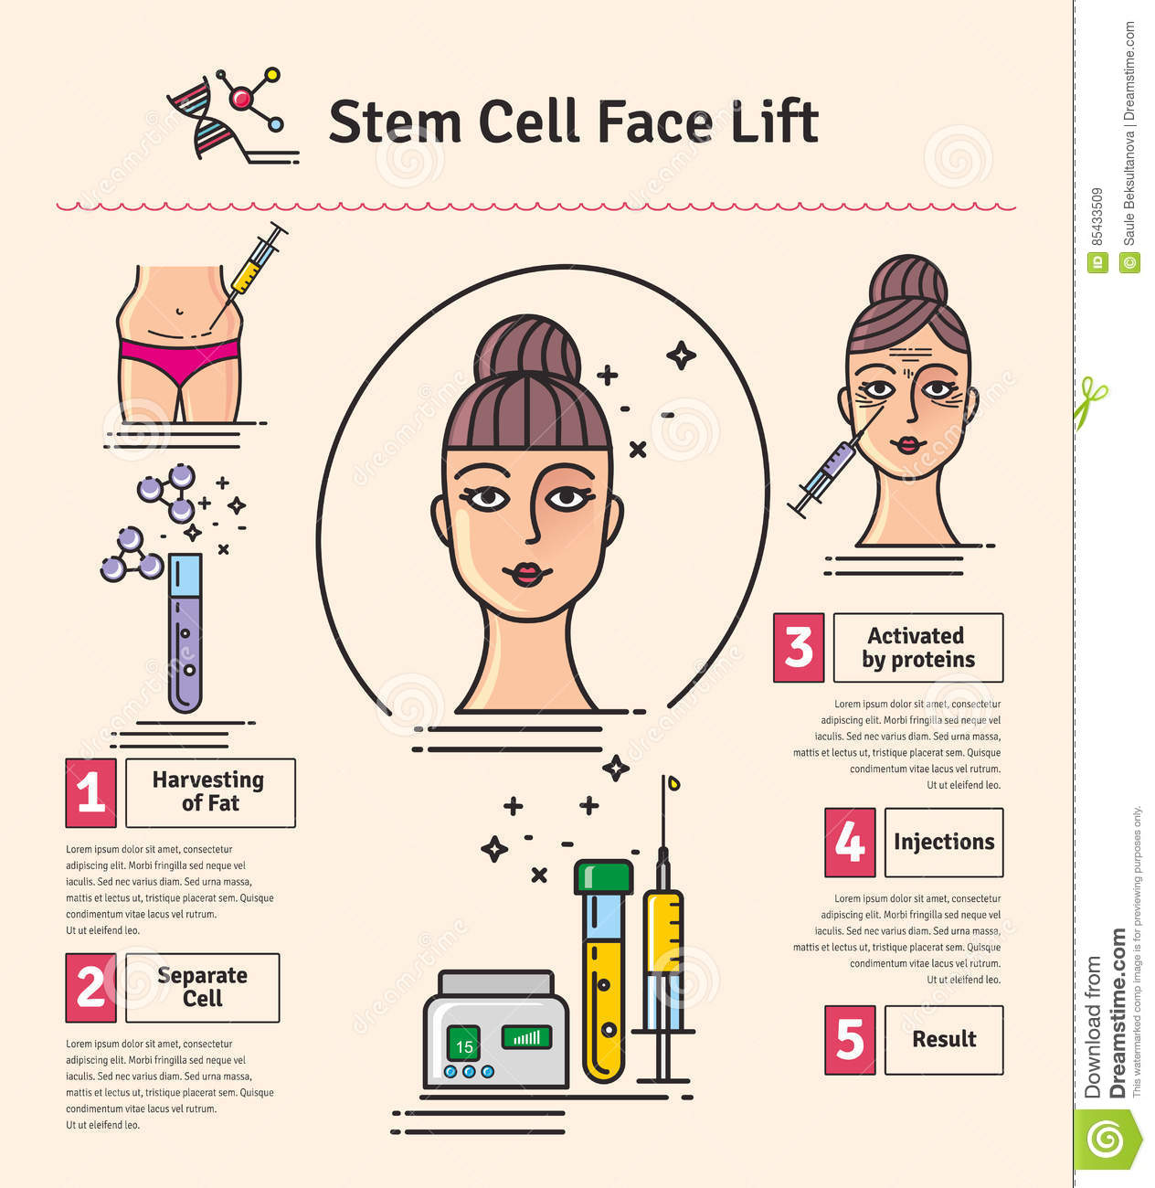
https://www.google.com/url?sa=i&url=https%3A%2F%2Fwww.dreamstime.com%2Fstock-illustration-vector-illustrated-set-cosmetology-stem-cell-facelift-infographics-icons-medical-cosmetic-procedures-image85433509&psig=AOvVaw0XN2HPkHJZr7LAMRCXX_7h&ust=1637672762696000&source=images&cd=vfe&ved=2ahUKEwiehMDLhKz0AhUWxCoKHeAPA7gQr4kDegUIARC4AQ

Slide 22
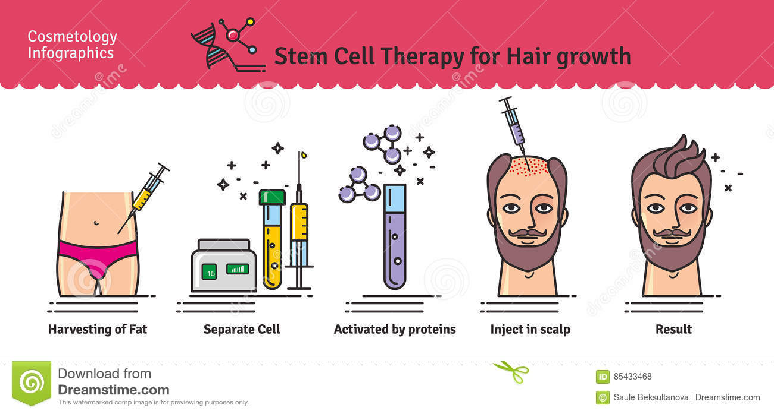
https://www.google.com/url?sa=i&url=https%3A%2F%2Fwww.dreamstime.com%2Fstock-illustration-vector-illustrated-set-stem-cell-therapy-hair-growth-cosmetology-infographics-icons-medical-cosmetic-procedures-image85433468&psig=AOvVaw0XN2HPkHJZr7LAMRCXX_7h&ust=1637672762696000&source=images&cd=vfe&ved=2ahUKEwiehMDLhKz0AhUWxCoKHeAPA7gQr4kDegUIARCzAQ

Slide 23
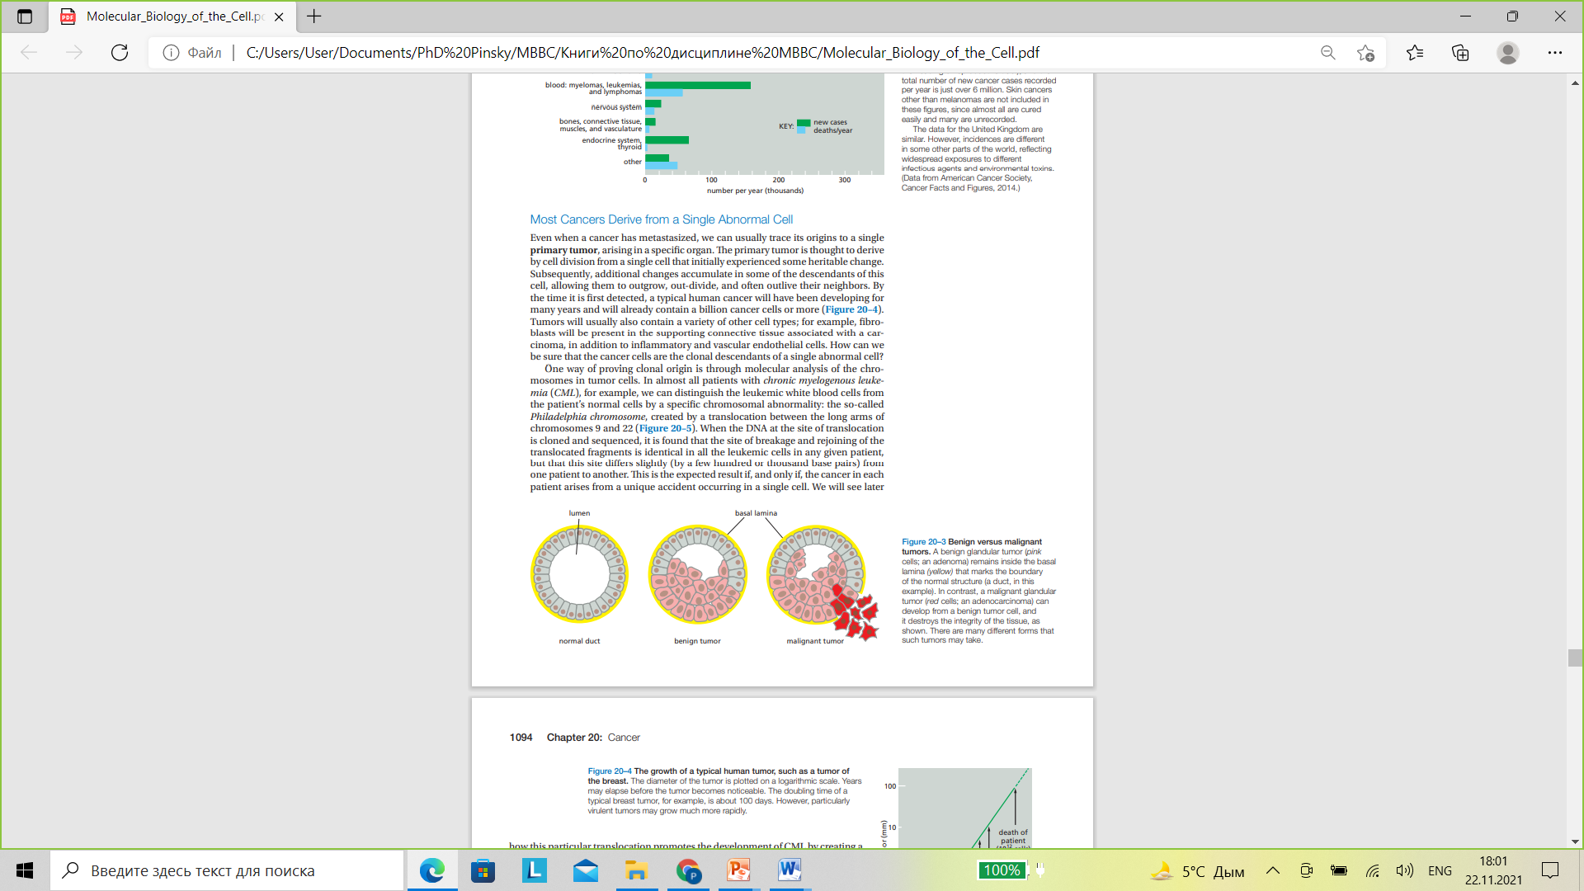

Slide 24
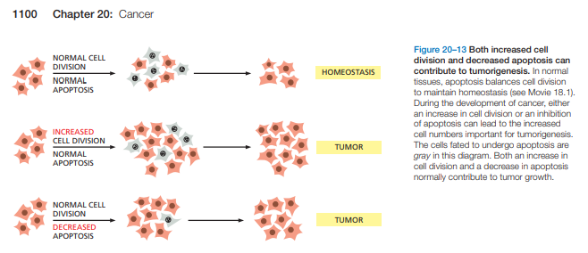

Slide 25
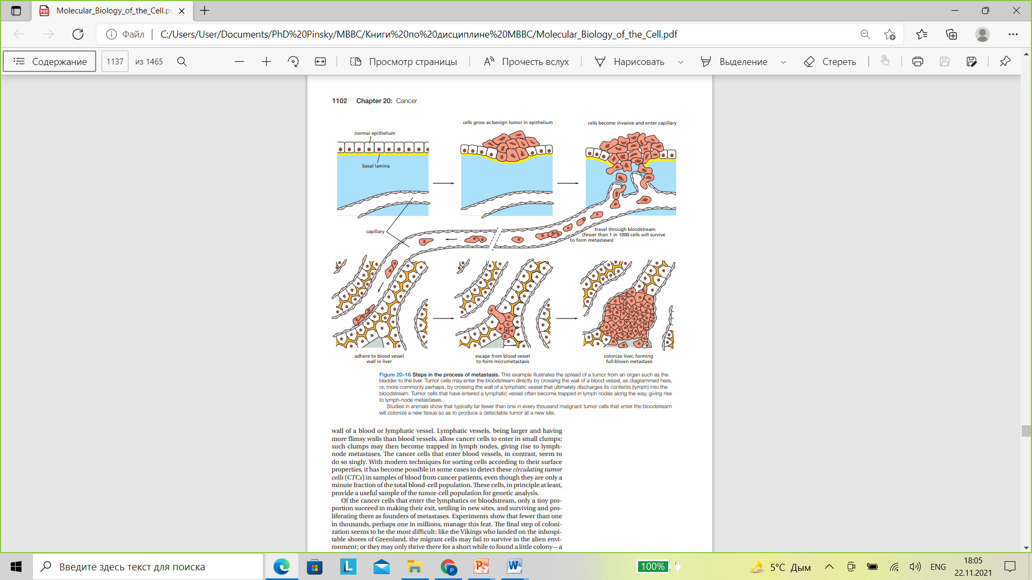

Slide 26
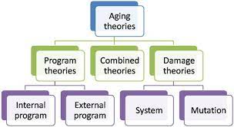
https://www.google.com/url?sa=i&url=https%3A%2F%2Feuropepmc.org%2Farticle%2Fpmc%2F5991498&psig=AOvVaw2CQcrxbEDIBTkL8Uu9lqvh&ust=1637673406839000&source=images&cd=vfe&ved=2ahUKEwjts9P-hqz0AhUNwSoKHWRlBuEQr4kDegUIARDXAQ

Slide 27
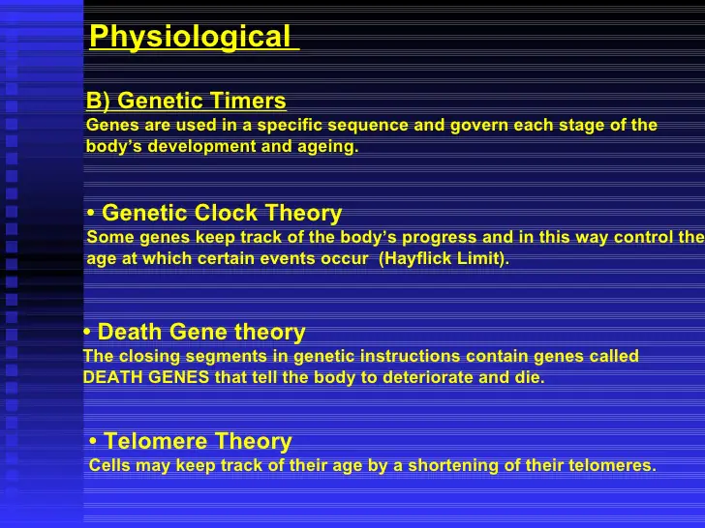
https://www.google.com/url?sa=i&url=https%3A%2F%2Fwww.slideshare.net%2Fhmirzaeee%2Faging-theories&psig=AOvVaw2CQcrxbEDIBTkL8Uu9lqvh&ust=1637673406839000&source=images&cd=vfe&ved=0CAwQjhxqFwoTCIjy2YGHrPQCFQAAAAAdAAAAABBR

Slide 28
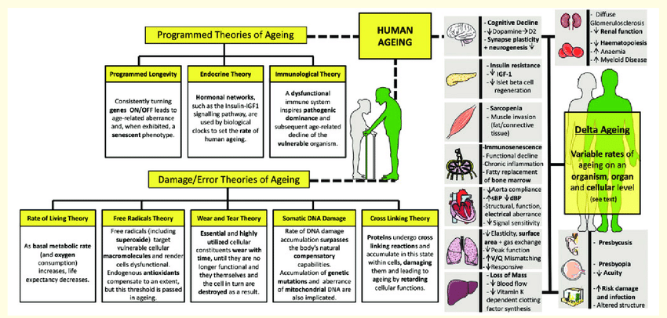
https://www.google.com/url?sa=i&url=https%3A%2F%2Fwww.researchgate.net%2Ffigure%2FHuman-ageing-theories-and-phenotypes-A-number-of-theories-aim-to-explain-human-ageing_fig1_338048376&psig=AOvVaw2CQcrxbEDIBTkL8Uu9lqvh&ust=1637673406839000&source=images&cd=vfe&ved=0CAwQjhxqFwoTCIjy2YGHrPQCFQAAAAAdAAAAABAP

Slide 29
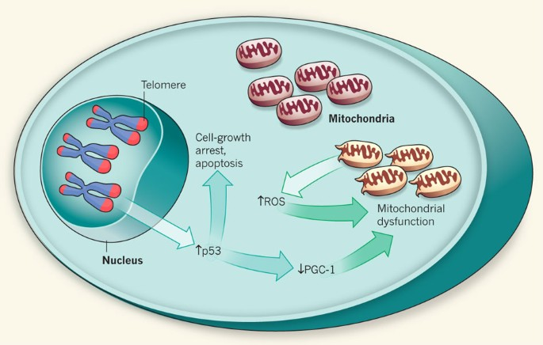
https://www.google.com/url?sa=i&url=https%3A%2F%2Fwww.nature.com%2Farticles%2Fnature09896&psig=AOvVaw2CQcrxbEDIBTkL8Uu9lqvh&ust=1637673406839000&source=images&cd=vfe&ved=0CAwQjhxqFwoTCIjy2YGHrPQCFQAAAAAdAAAAABAy

